Slide 1

Data-Driven Review of Program Effectiveness
Braven Program Insights and Analysis
By Karim Toufiq

Slide 2
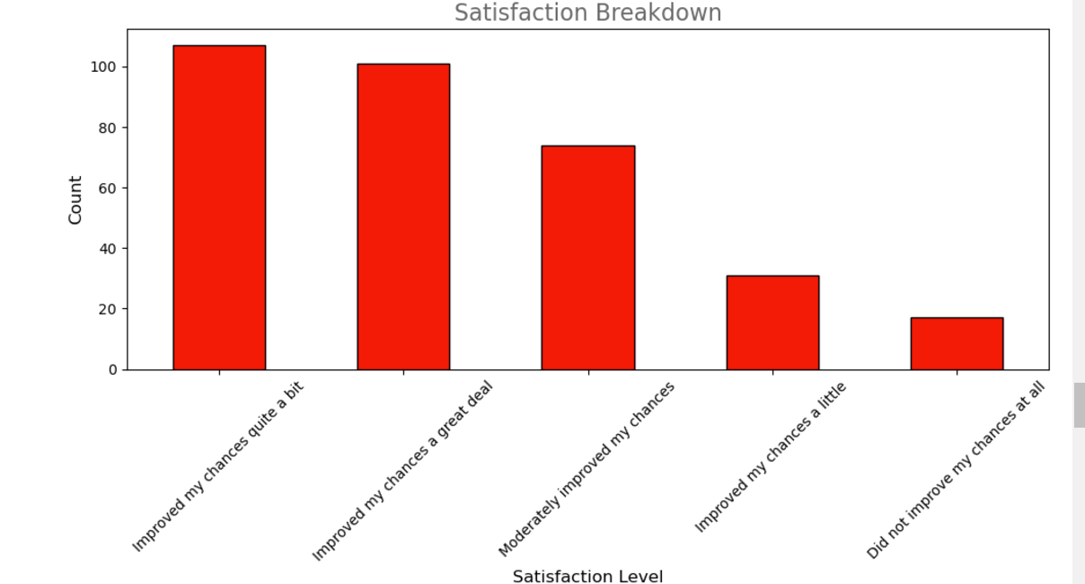
Overall Satisfaction Insights
Majority Positive Impact: 76% felt the program improved their chances significantly.
Moderate to Little Impact: 23% reported moderate or little improvement.
Low Satisfaction: 5% felt no improvement at all.

Slide 3
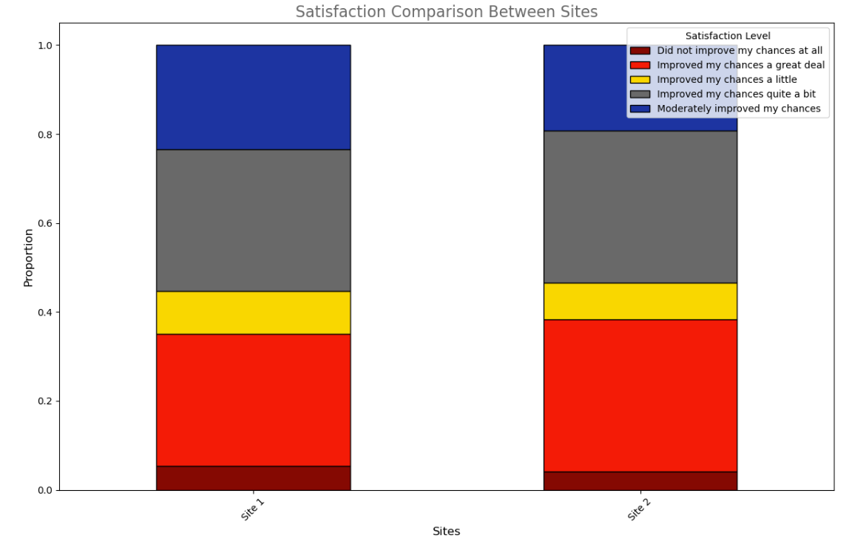
Satisfaction by Program (Site Comparison)
Site 1: ~62% high satisfaction; ~15% low satisfaction.
Site 2: ~68% high satisfaction; ~12% low satisfaction.

Slide 4
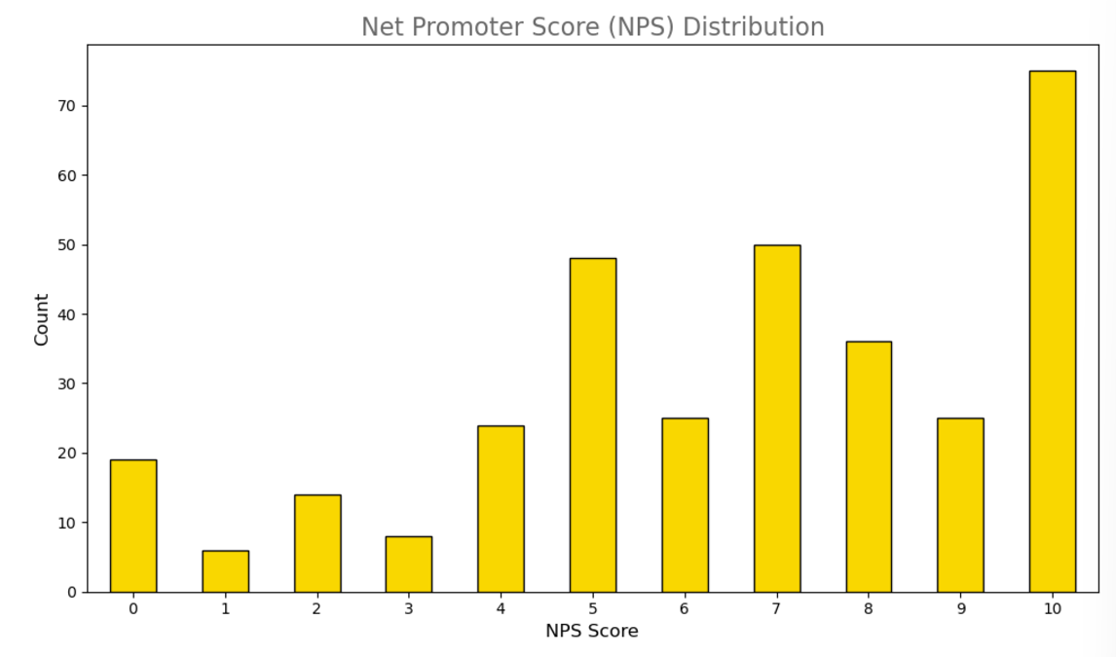
NPS Score Distribution
Promoters: 30.30% represent strong program advocates.
Passives: 26.06% are satisfied but less likely to recommend.
Detractors: 43.64% indicate dissatisfaction.

Slide 5
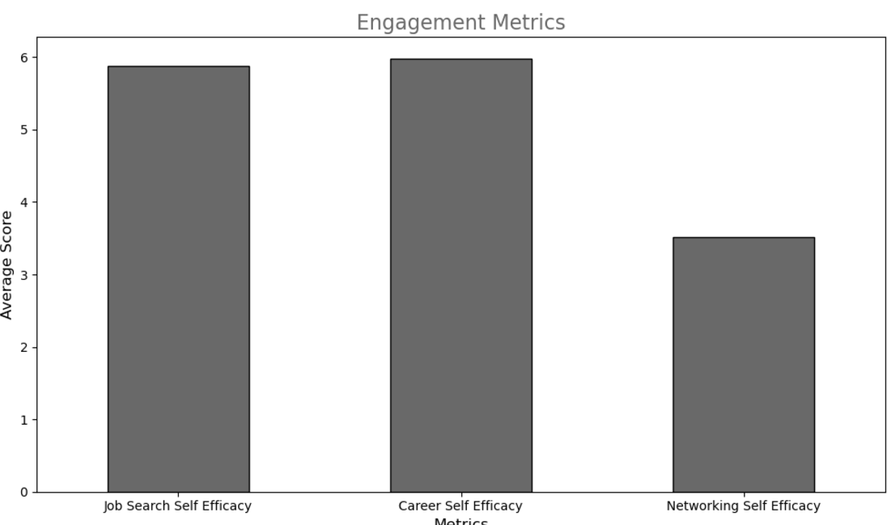
Job Search: Mean of 5.87, consistent confidence.
Career: Mean of 5.98, slightly higher confidence.
Networking: Mean of 3.52, highlighting a weaker area.
Engagement Metrics

Slide 6
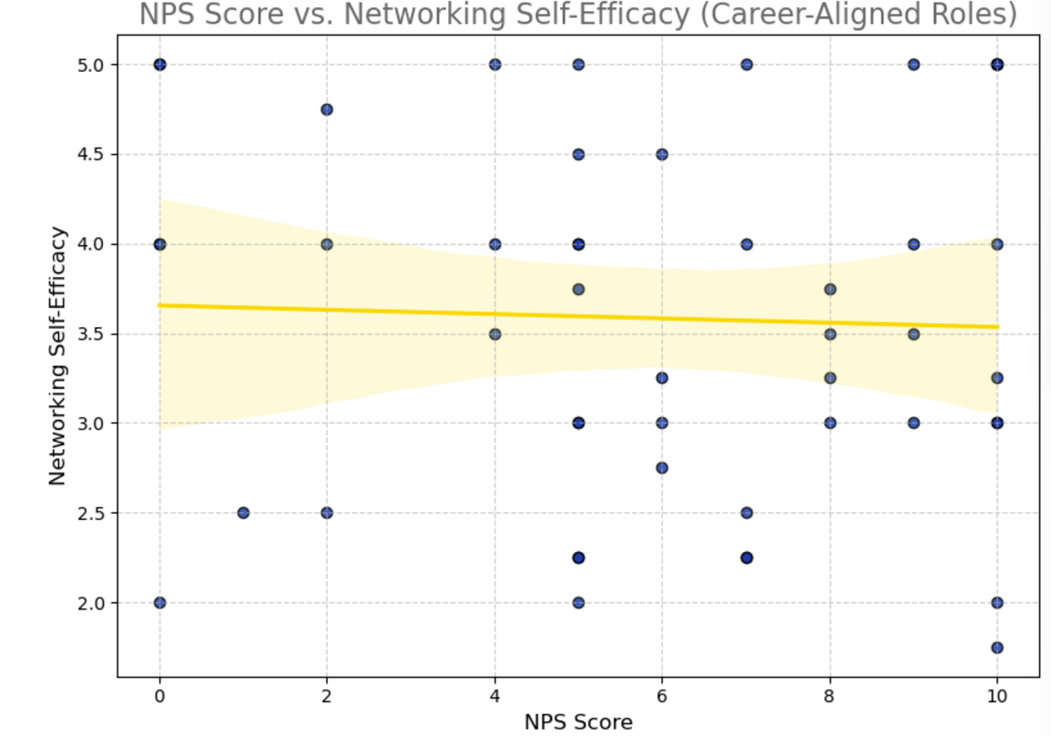
Career Alignment and Networking Correlation
Positive correlation: Career alignment enhances NPS and networking confidence.
Career-aligned participants report higher satisfaction.

Slide 7
Recommendations
Address Detractor Concerns: Focus on areas of dissatisfaction from feedback.
Strengthen Networking Opportunities: Introduce targeted workshops and mentorship.
Enhance Career Alignment: Expand career-relevant program opportunities.
Replicate Site 2 Success at Site 1: Adapt strategies that drive higher satisfaction.

Slide 8
Next Steps
Develop and pilot new workshops focusing on networking and career alignment.
Monitor satisfaction trends to evaluate progress.
Dive into qualitative feedback for actionable insights.

